Slide 1
Introduction to Dimensional Analysis
Objective: Students will be able to use the Dimensional Analysis Method in order to perform Unit Conversions.

Slide 2
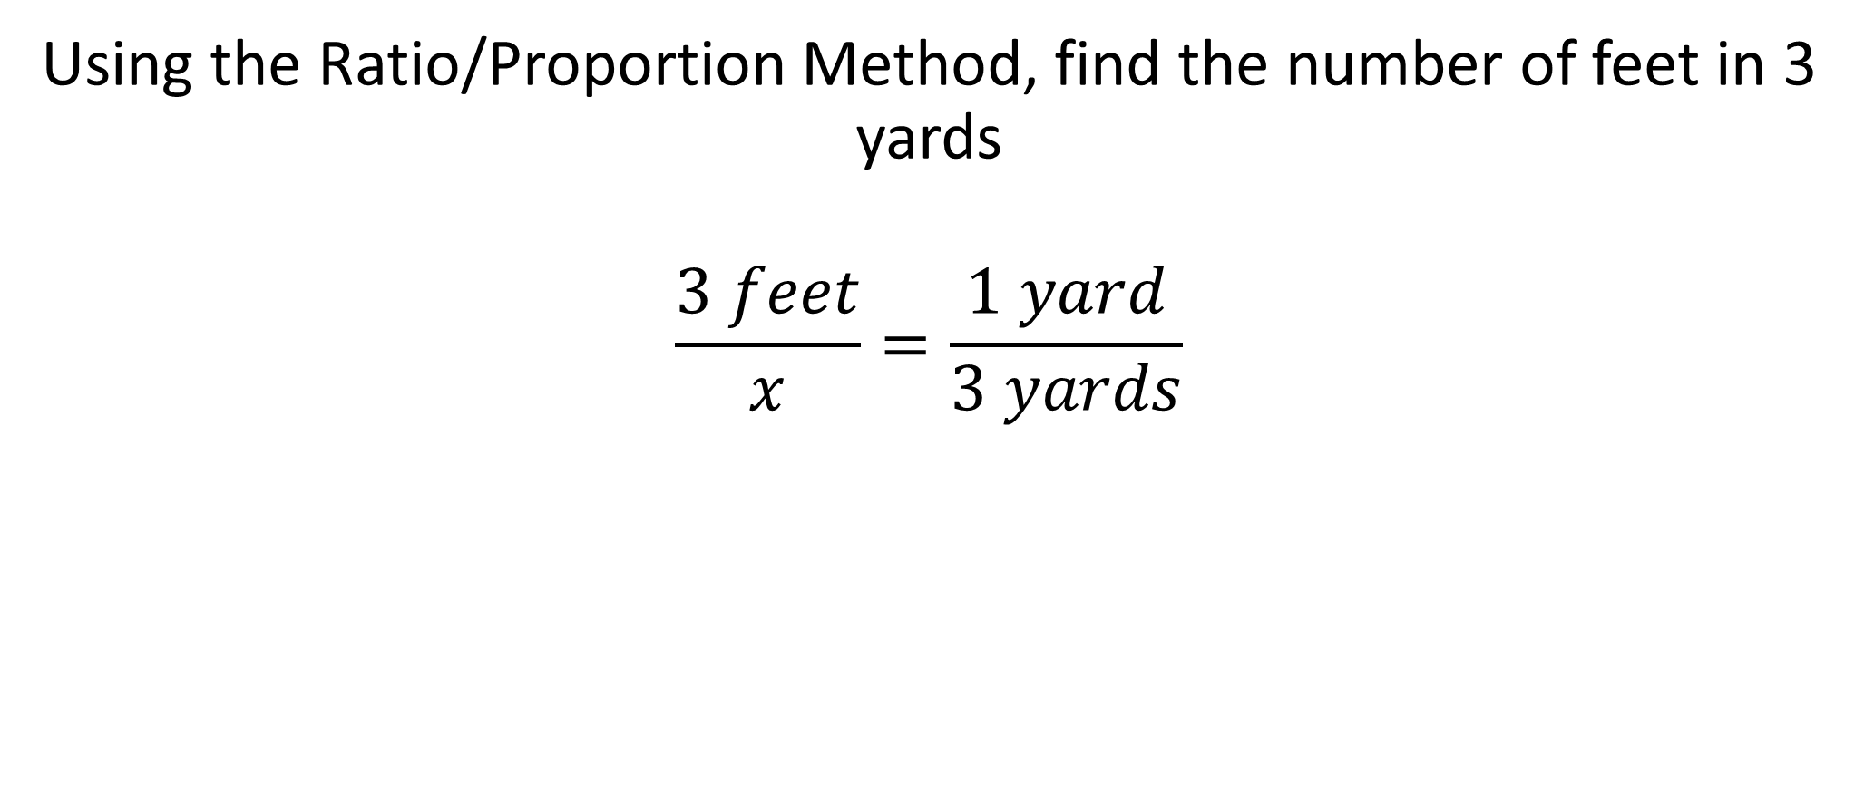
Introduction to Dimensional Analysis
Using the Ratio/Proportion Method, find the number of feet in 3 yards
$$\frac{3 feet}{x}=\frac{1 yard}{3 yards}$$

Slide 3
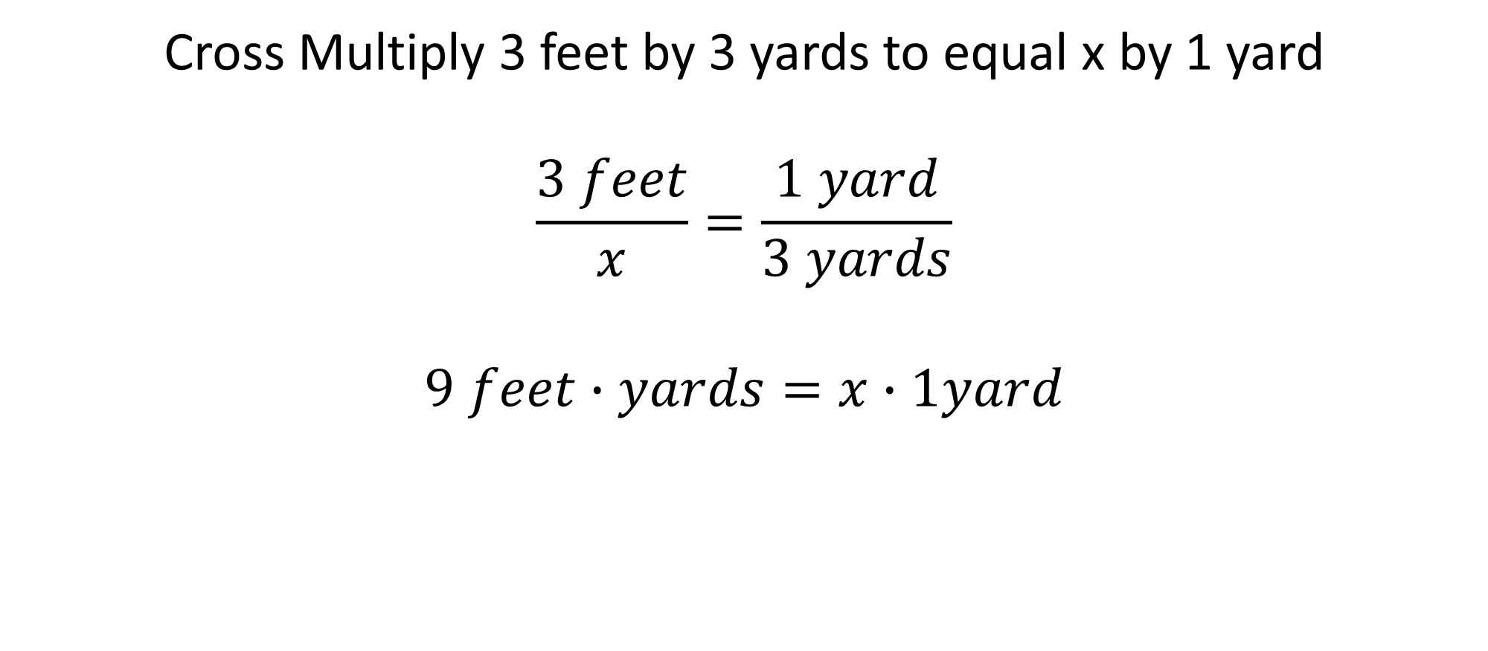
Introduction to Dimensional Analysis
Cross Multiply 3 feet by 3 yards to equal x by 1 yard
$$\frac{3 feet}{x}=\frac{1 yard}{3 yards}$$
$$9 feet∙yards=x∙1yard$$

Slide 4
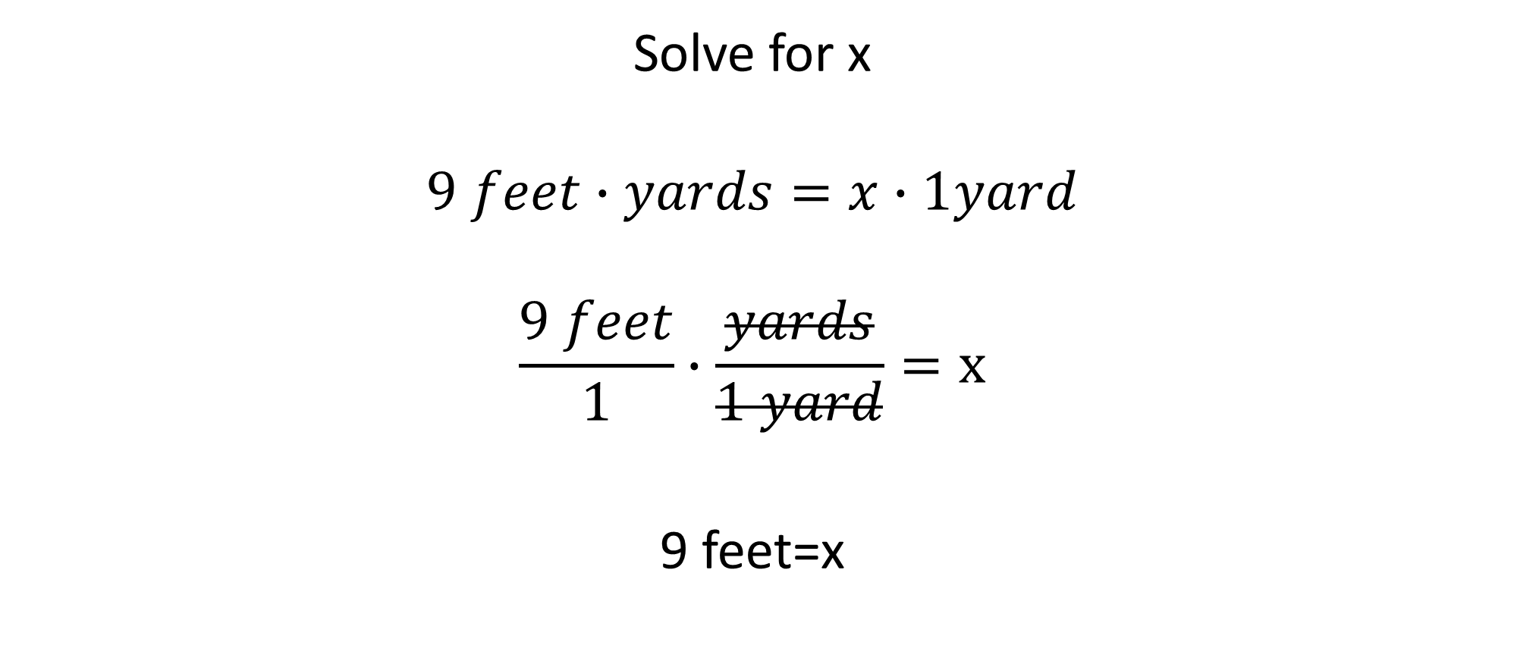
Introduction to Dimensional Analysis
Solve for x
$$9 feet∙yards=x∙1yard$$
$$\frac{9 feet}{1}∙\frac{yards}{1 yard}=x$$
9 feet=x

Slide 5
Introduction to Dimensional Analysis
Notice that in the last step, the units of yards were cancelled.
If that was the case, let’s take a shortcut and just set up the equation to cancel out unwanted units.
Enter Dimensional Analysis

Slide 6
Introduction to Dimensional Analysis
Dimensional Analysis Formula
Units Desired = Units Given × Ratio Factor

Slide 7
Introduction to Dimensional Analysis
Units Desired = Units Given × Ratio Factor
Example: How many centimeters are in 6 inches?
Units Desired: centimeters
Units Given: inches
Ratio factor: 1 inch equals 2.54 cm

Slide 8
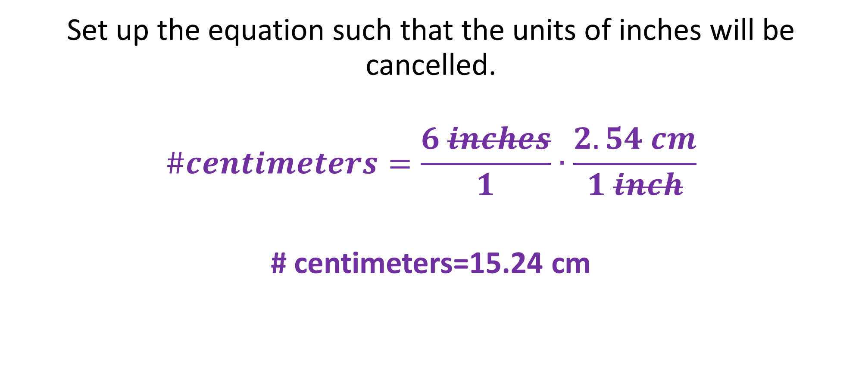
Introduction to Dimensional Analysis
Set up the equation such that the units of inches will be cancelled.
$$\#centimeters=\frac{6 inches}{1}∙\frac{2.54 cm}{1 inch}$$
# centimeters=15.24 cm

Slide 9
Introduction to Dimensional Analysis
The Dimensional Analysis method can also be used to perform multiple conversions.
Units desired=Units given×Ratio Factor 1×Ratio Factor 2
Example: 2400 seconds equal ? Hours
Units desired: hours
Units given: seconds
Ratio factor 1: 60 seconds=1 min., Ratio factor 2: 60 min.=1 hr

Slide 10
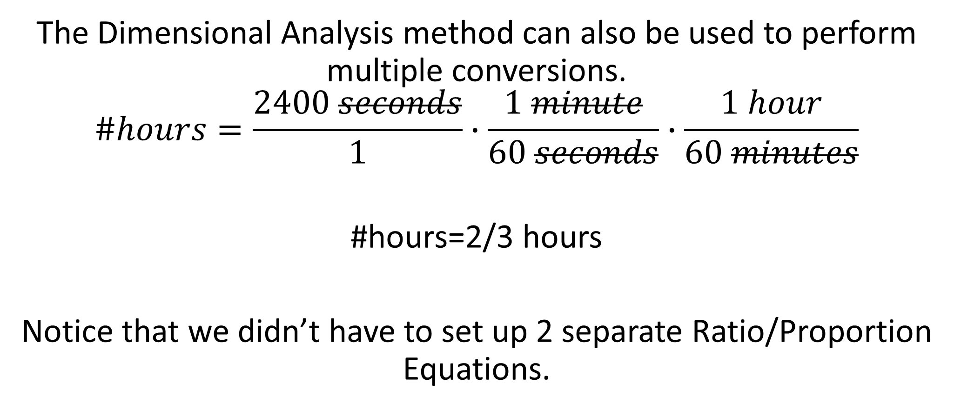
Introduction to Dimensional Analysis
The Dimensional Analysis method can also be used to perform multiple conversions.
$$\#hours=\frac{2400 seconds}{1}∙\frac{1 minute}{60 seconds}∙\frac{1 hour}{60 minutes}$$
#hours=2/3 hours
Notice that we didn’t have to set up 2 separate Ratio/Proportion Equations.

Slide 11
Conclusion
Units Desired = Units Given × Ratio Factor
Units desired=Units given×Ratio Factor 1×Ratio Factor
300 kg equal how many pounds?, 1 kg=2.202 lb
5 miles equal how many inches?, how many yards?, 1 mile=5,280 feet, 1 foot=12 inches, 3 feet=1 yard

